Slide 1
Week 1: Set up

Slide 2
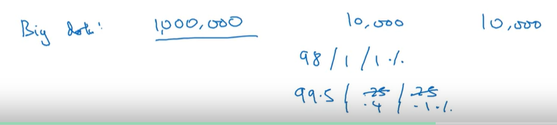
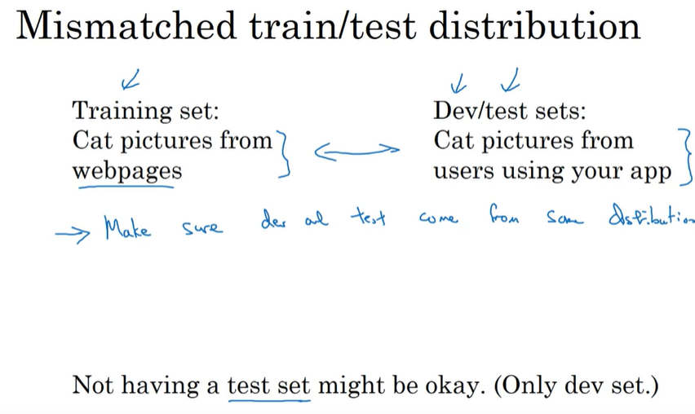
In order to gather more training data

Slide 3
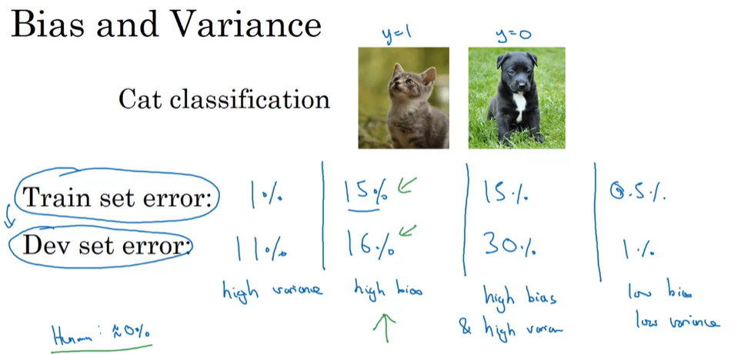

Slide 4
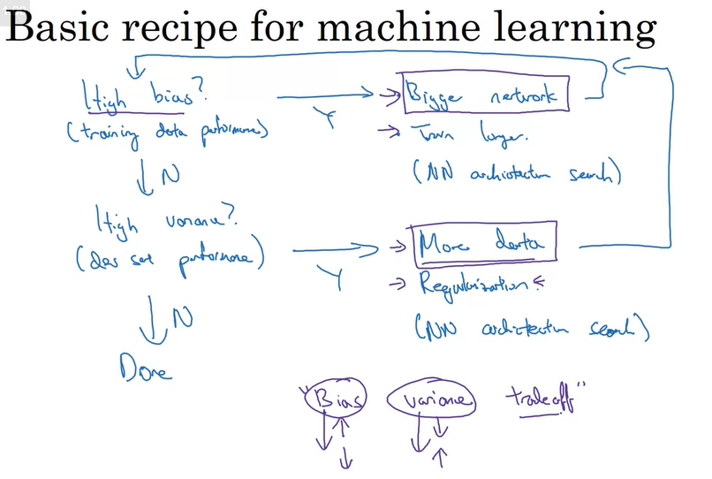
Underfitting
Overfitting

Slide 5
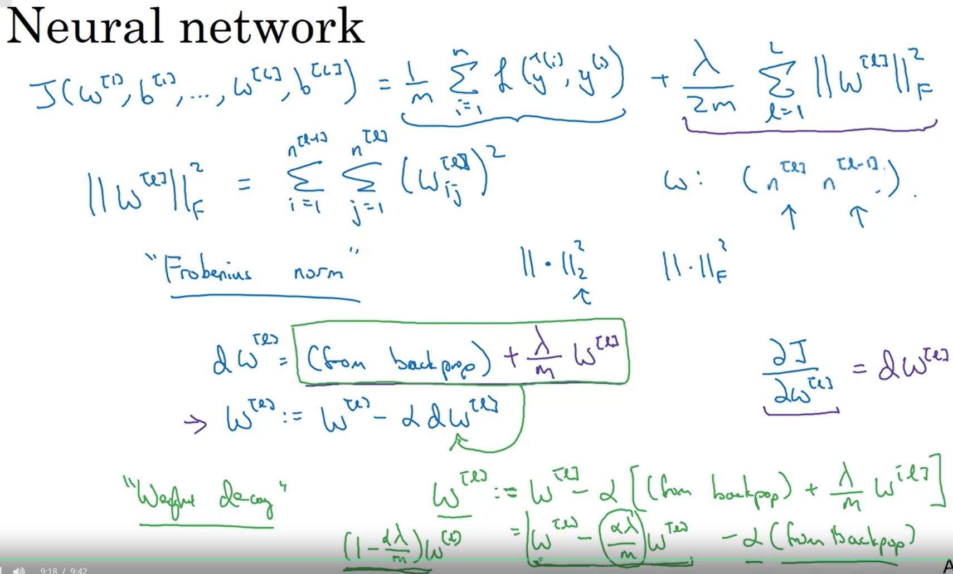
L2 Regularisation

Slide 6
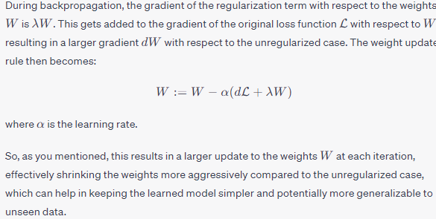
L2 regularization, often referred to as weight decay, is primarily used to prevent overfitting in neural networks by adding a penalty term to the loss function. This penalty term is proportional to the sum of squares of the weights (parameters) of the network, thus encouraging the learning algorithm to keep the weights small

Slide 7
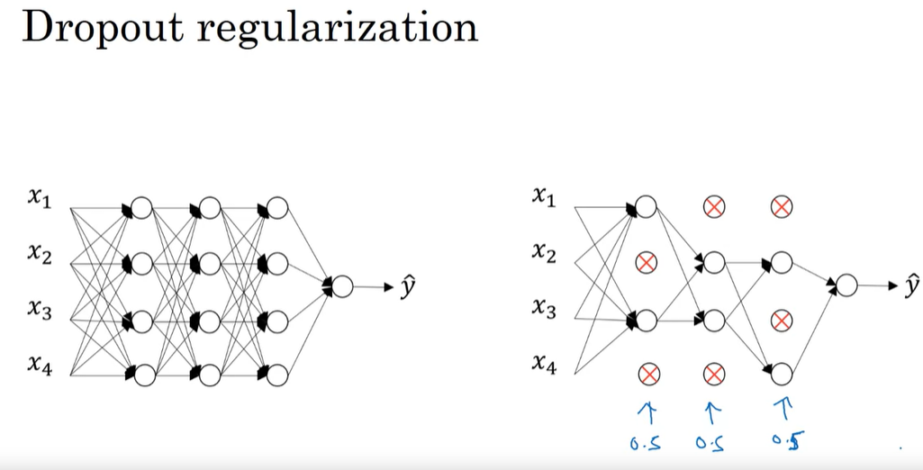

Slide 8
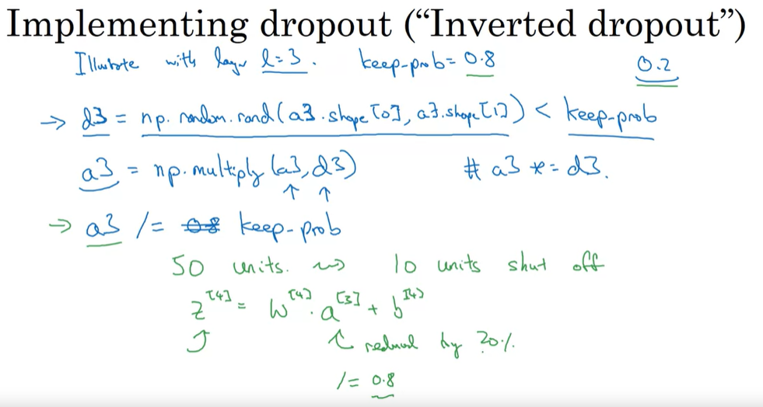
Each iteration zero out different neurons!

Slide 9
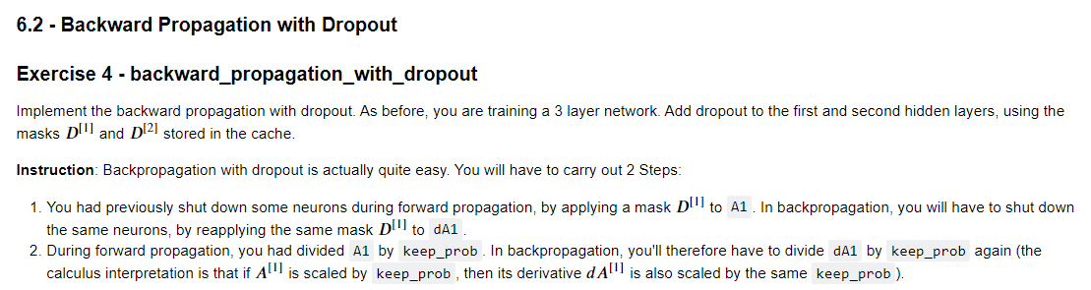

Slide 10
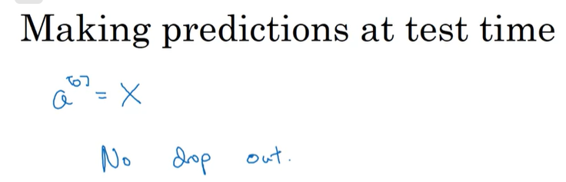
Dropout is frequently used in CV

Slide 11
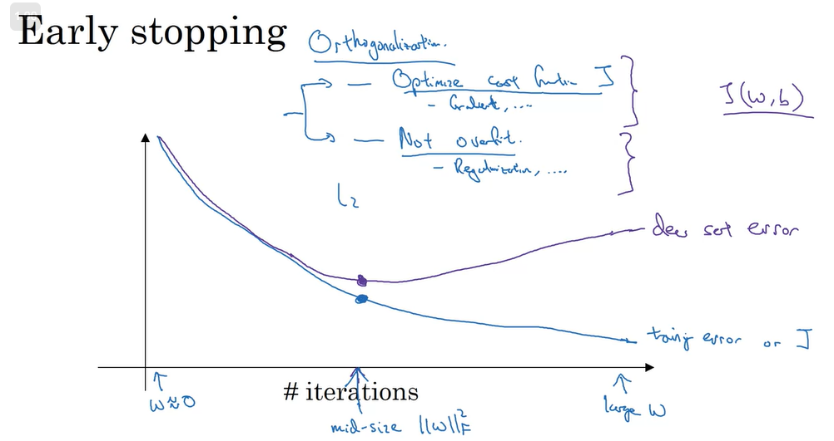

Slide 12
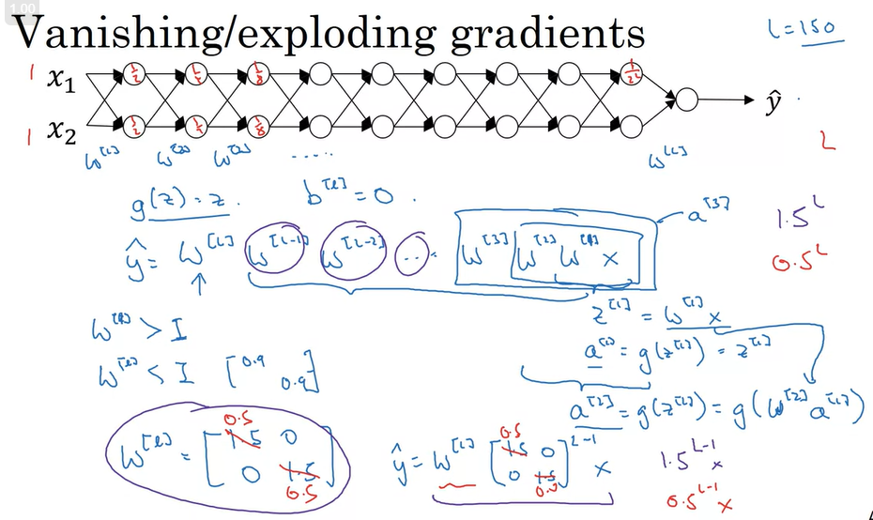

Slide 13
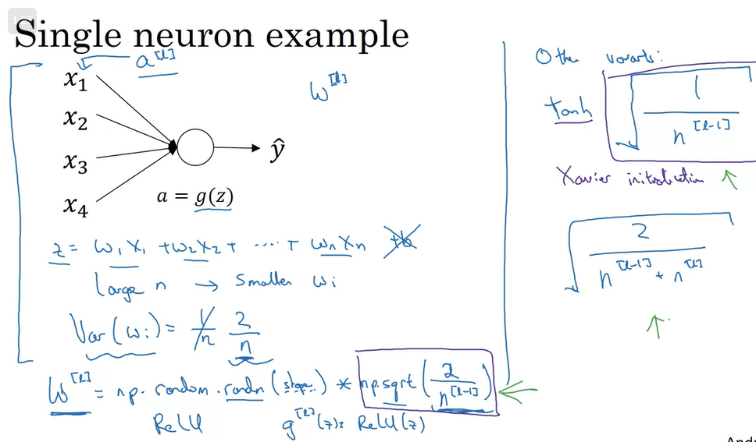
Weight initialization

Slide 14
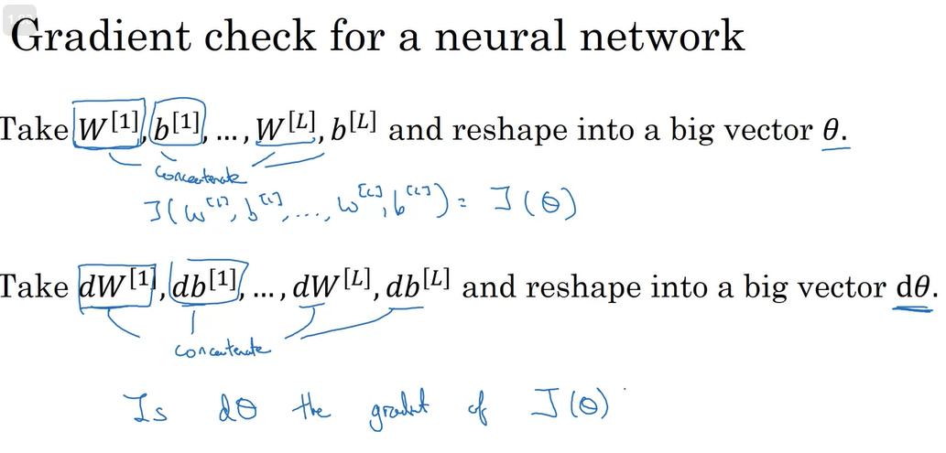

Slide 15
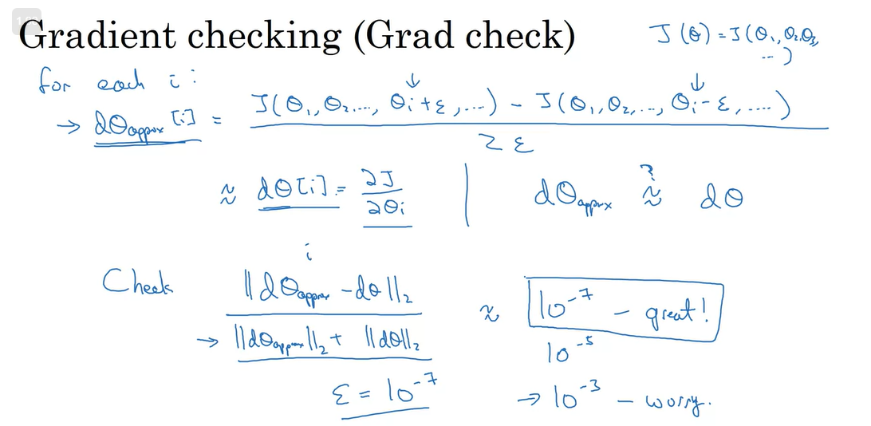

Slide 16
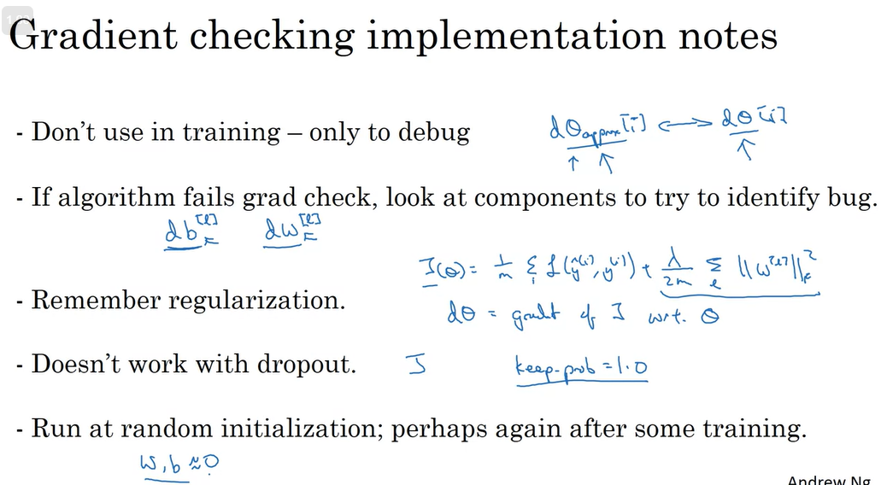

Slide 17
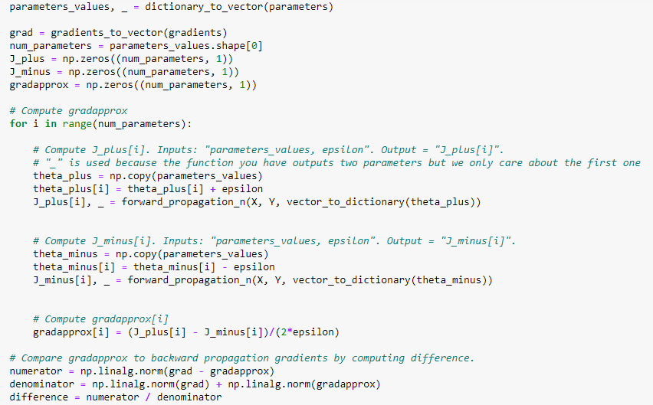
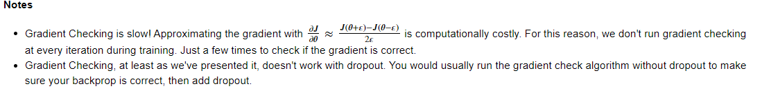
ICLR
NIPS
ICML

Slide 18
Week 2: Optimization

Slide 19
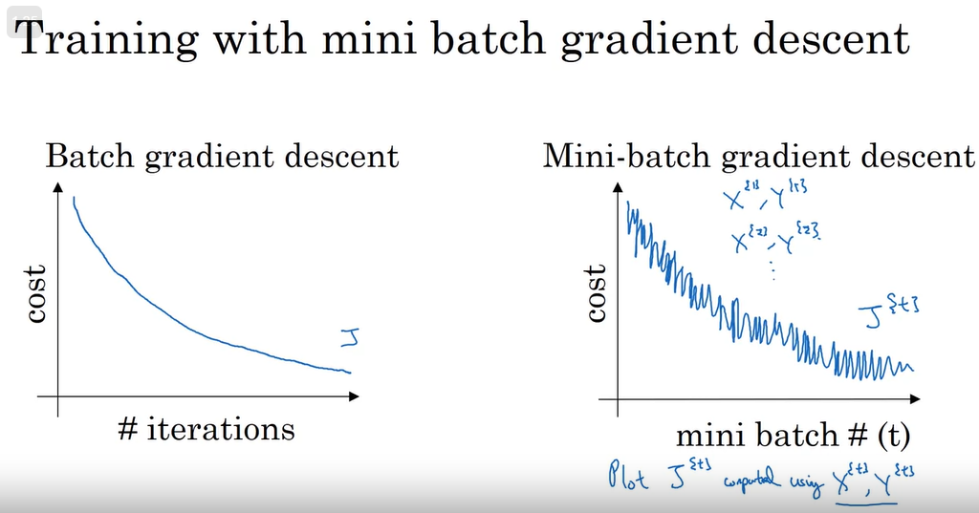
1 epoch is a pass through training set, in mini-batch GD, 1 epoch will update multiple times (total number / batch size) the weight of neural nets.

Slide 20
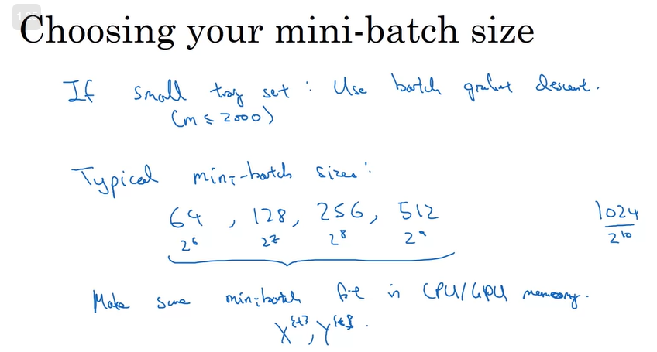
Shuffling and Partitioning are the two steps required to build mini-batches

Slide 21
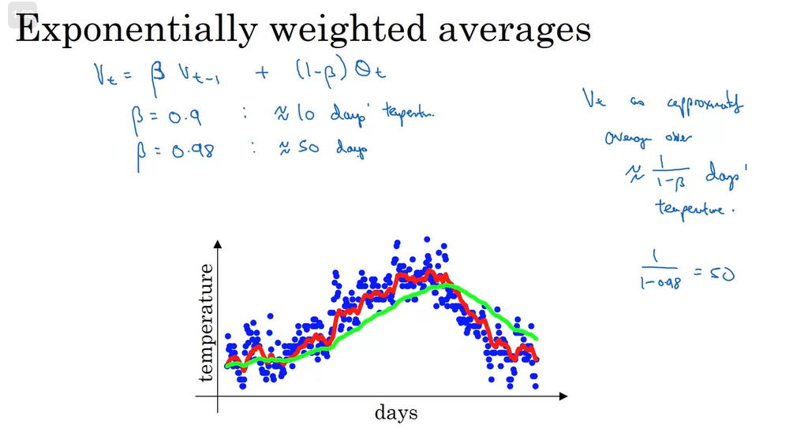
Moving average

Slide 22
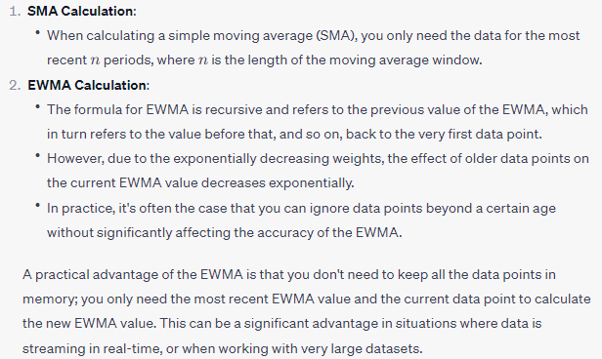

Slide 23
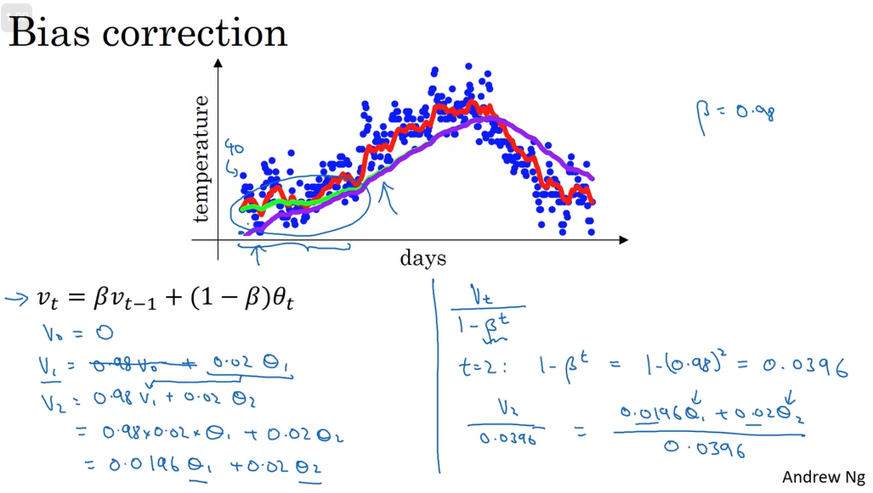
Not really needed, because we care more about the outcome, not the beginning

Slide 24
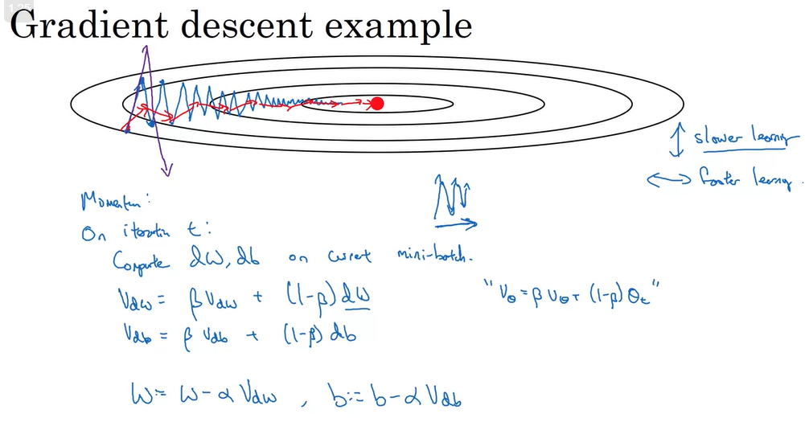
Momentum takes past gradients into account to smooth out the steps of gradient descent.

Slide 25
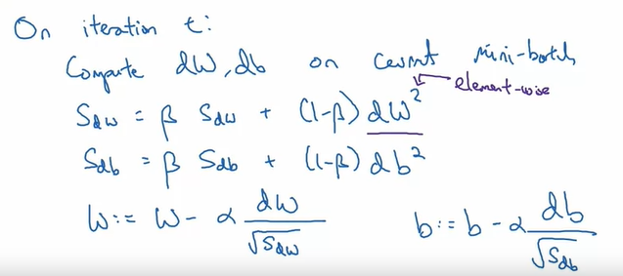

RMSProp
magnitude of historical gradients
adapt the learning rates, based on the magnitude of historical gradients
梯度小的地方大步走（learning rate 大），梯度大的地方小步走（learning rate 小）
This has the effect of scaling down the gradient in regions where the loss surface is steep, and scaling it up in flatter regions.

Slide 26
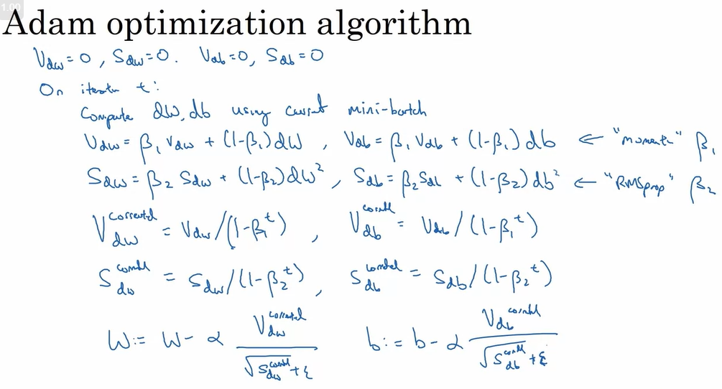
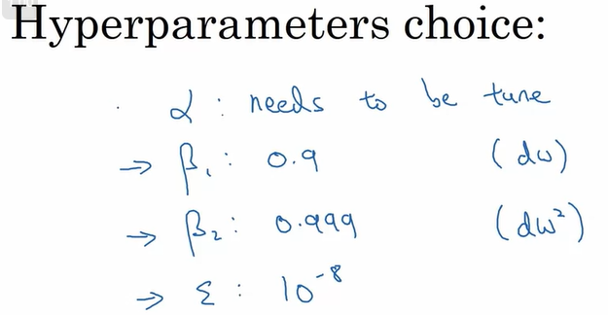

Slide 27
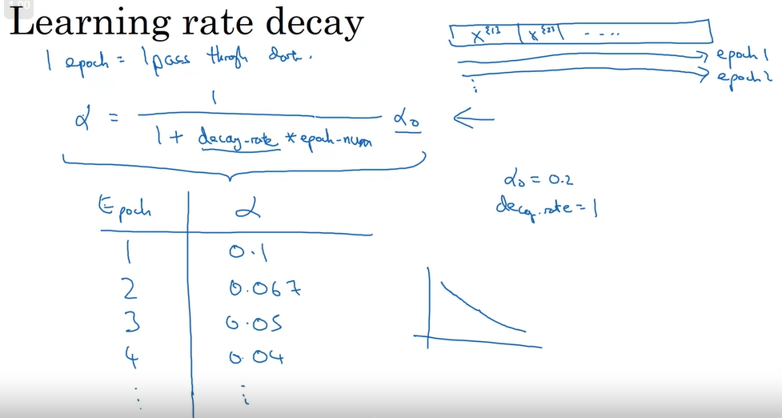
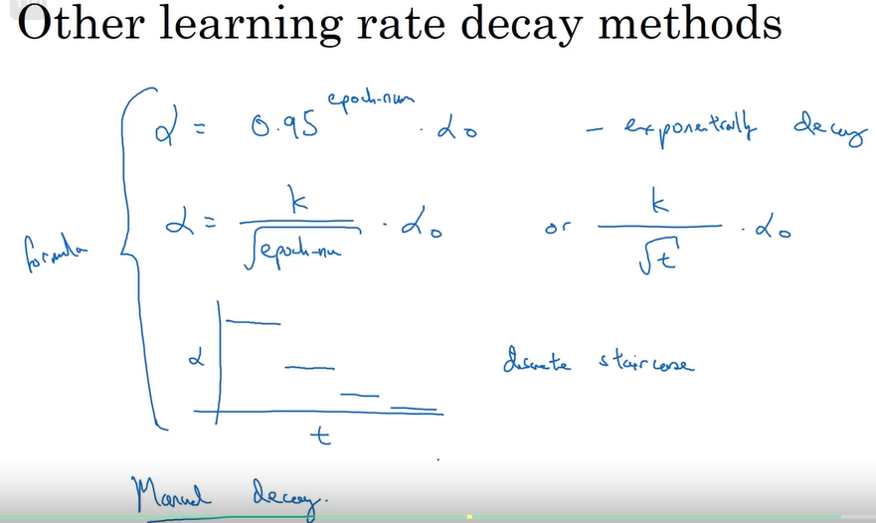


Slide 28
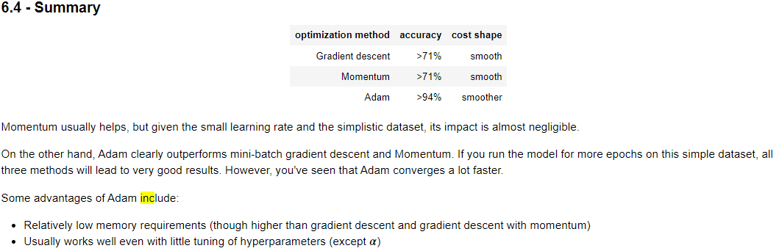
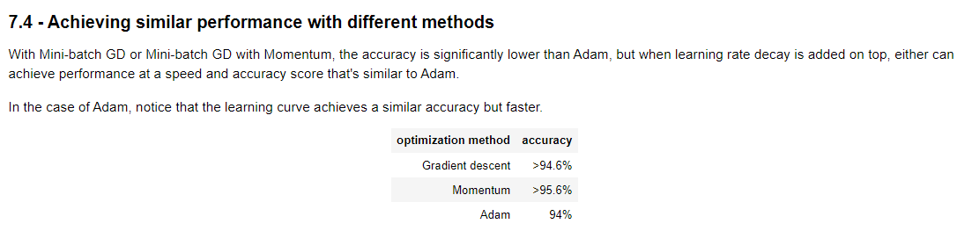

Slide 29
Week 3: Tuning

Slide 30
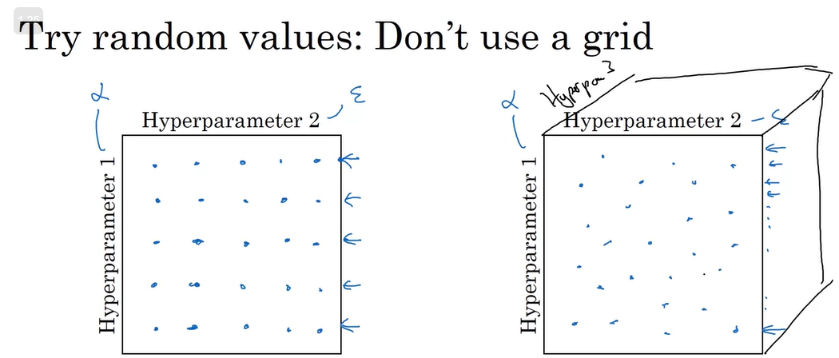
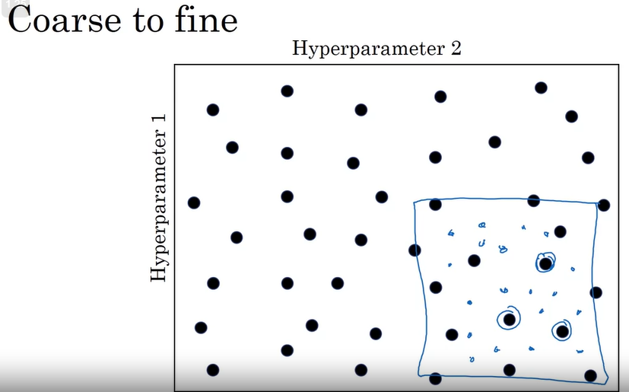

Slide 31
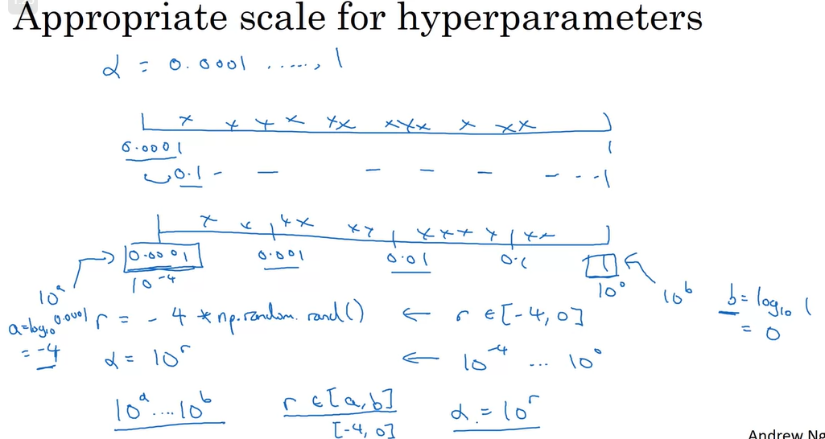
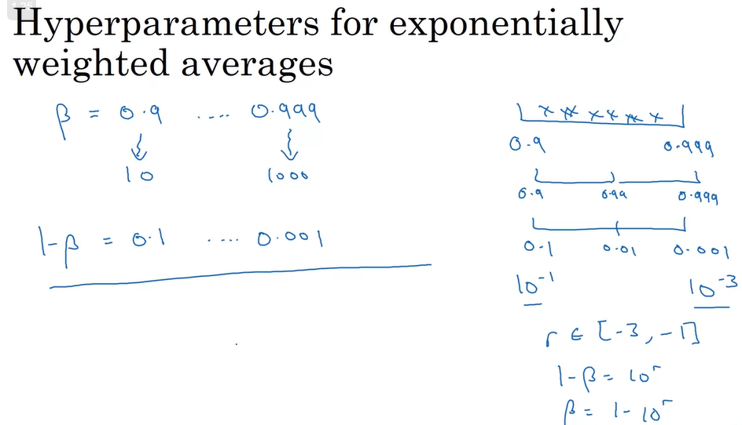

Log scale for lr

Slide 32
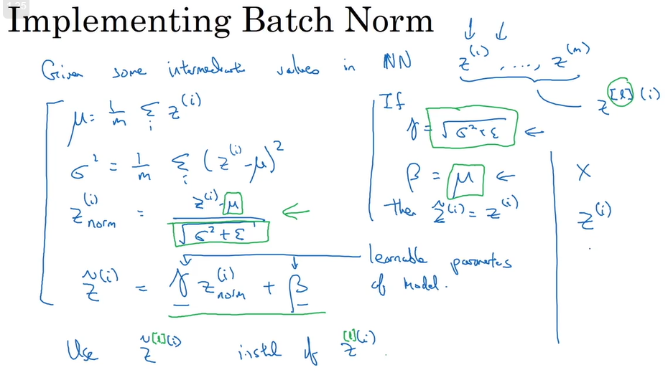


Slide 33
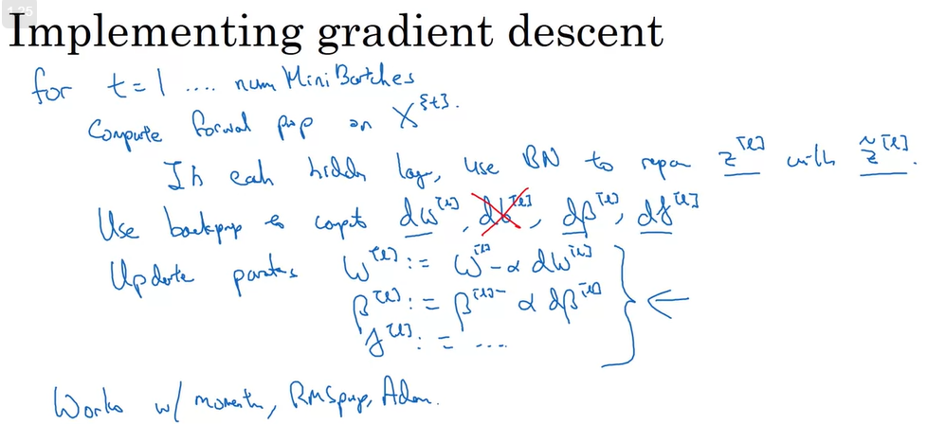

Slide 34
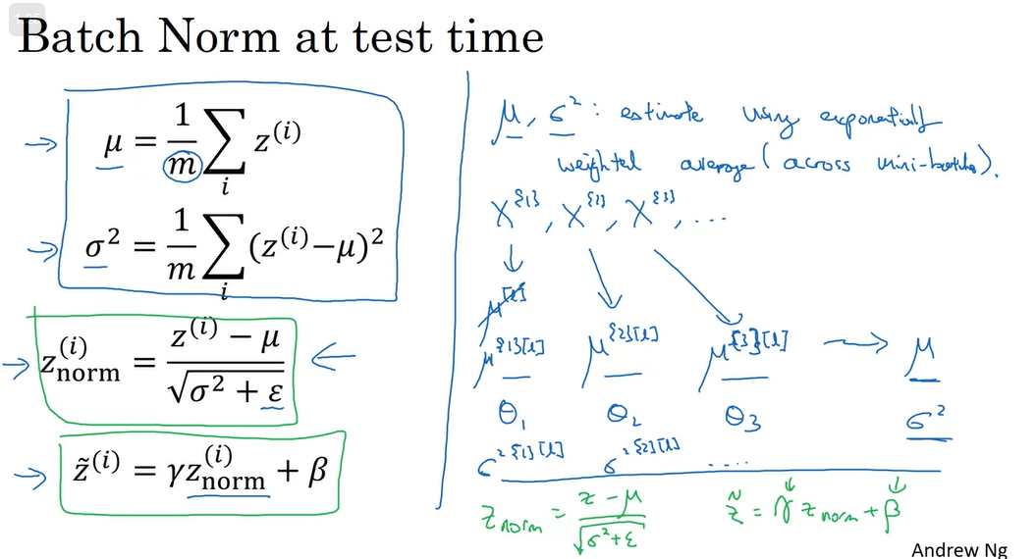
Using running average from training in test

Slide 35
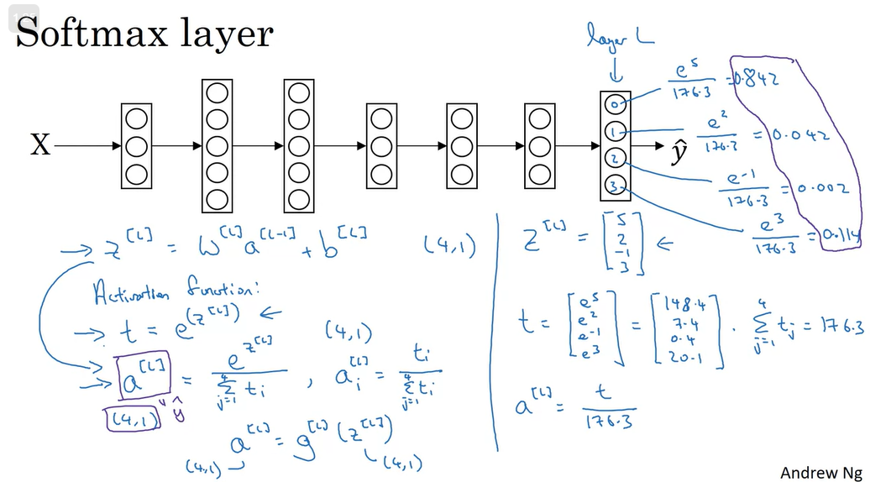

Slide 36
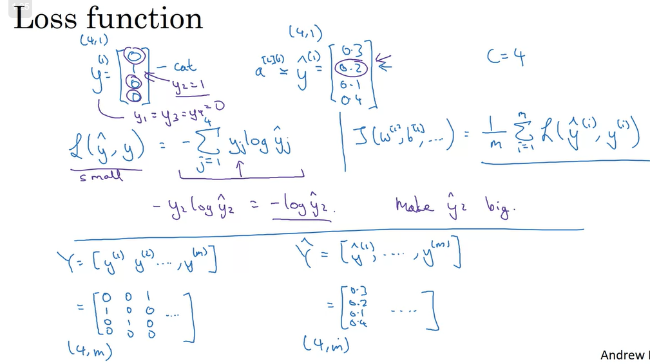
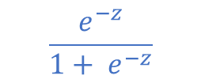
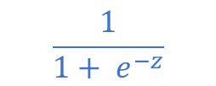

If C = 2, softmax reduces to logistic regression
$$\frac{1}{1+ e^{−z}}$$
P(y =1):
P(y =0):
$$\frac{e^{−z}}{1+ e^{−z}}$$

Slide 37
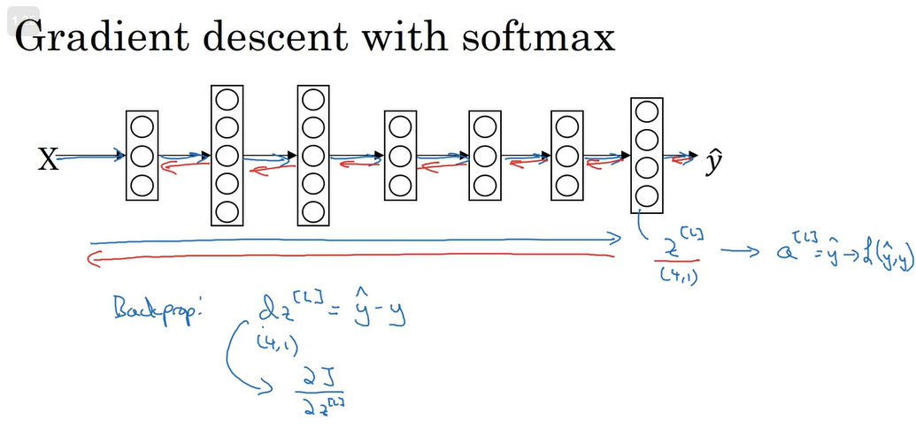


$${dZ}^{[L]}=A^{[L]} −Y$$
same as using logistic regression as the last layer !

Slide 38
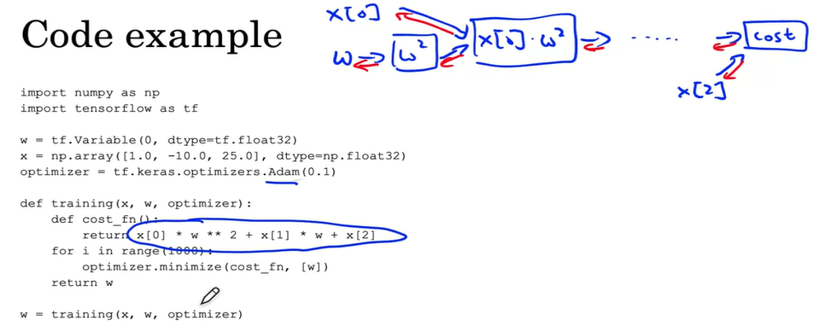

Slide 39
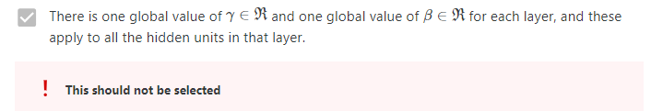
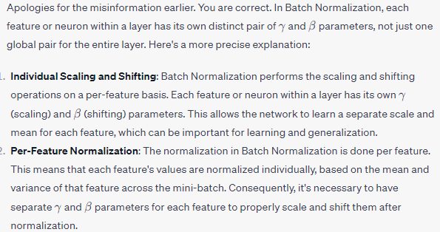

Slide 40
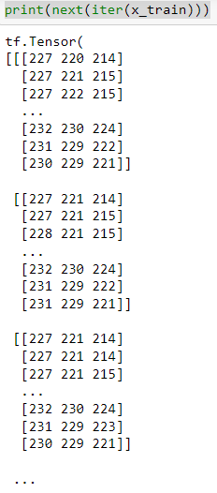
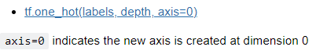
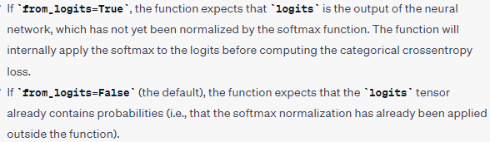
This is one row of pixels
The output tensor will have its "depth" as the first dimension
Why Using map?

Slide 41
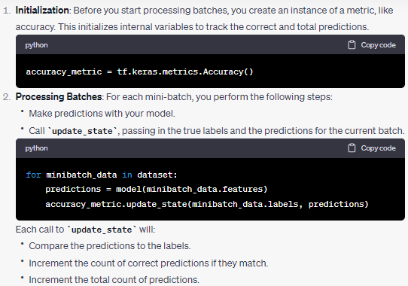


Slide 42


